Slide 1
eBay / Testing MODULE
Under Guidance of Mrs. Vaishali Sonawane Madam

Slide 2
Introduction :
eBay is a global e-commerce marketplace where users can buy and sell products. With millions of traffic daily, ensuring a smooth, secure, and bug-free experience is critical.
Testing helps identify issues in functionality, performance, and security before they impact users.

Slide 3
Overview
What is eBay?
eBay is a global online marketplace that connects buyers and sellers for both new and used goods.
It operates in multiple countries, supporting consumer-to-consumer (C2C) and business-to-consumer (B2C) sales.
This project involves Testing eBay's core features—login, search, cart, profile, categories, descriptions, and language—to ensure they work perfectly for users.

Slide 4
Modules
Module 1 : Log in page
Checked all the functionalities on Log-in page which included email address, password, continue and submission button functionalities.
Module 2 : Search Module
Tests if the search bar finds products, shows suggestions, and handles wrong/no inputs.
Module 3 : Cart Management
Tests adding/removing items from the cart to ensure smooth checkout.
Module 4 : Profile Settings
Checks if users can update their login name and shipping address correctly.
Notes:
Module 1: Signn in page
Checked all the functionalities on Sign in page which included personal info as email
address, password
Module 2: Women page
Checked all the functionalities on Women page which included item details, Quantity, Filters,compare button,Add to cart button,product info,grid,list button
Module 3: Tshirt page
Checked all the functionalities on T-Shirt page which included item details, Quantity, Filters,compare button,Add to cart button,product info,grid,list button
Module 4: All Buttons and Drop Down Arrow :
team checked if all the buttons and drop down arrows of different fields are functioning properly or not

Slide 5
Module 5 : Category Navigation
Tests if browsing products by categories works, including the "All Categories" section.
Module 6 : Product Description
Verifies if right-clicking on product images shows descriptions (if supported).
Module 7 : Language Settings
Tests if changing the app language updates menus/text instantly.

Slide 6
Defects
While running a testcase at certain point some fields are not working as it is expected which is nothing but a defect, so I have created a Defect report on those defects.

Slide 7
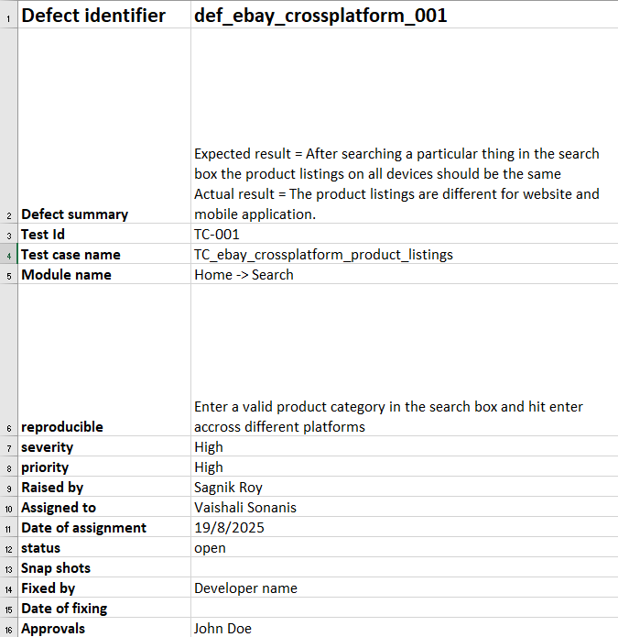

Slide 8

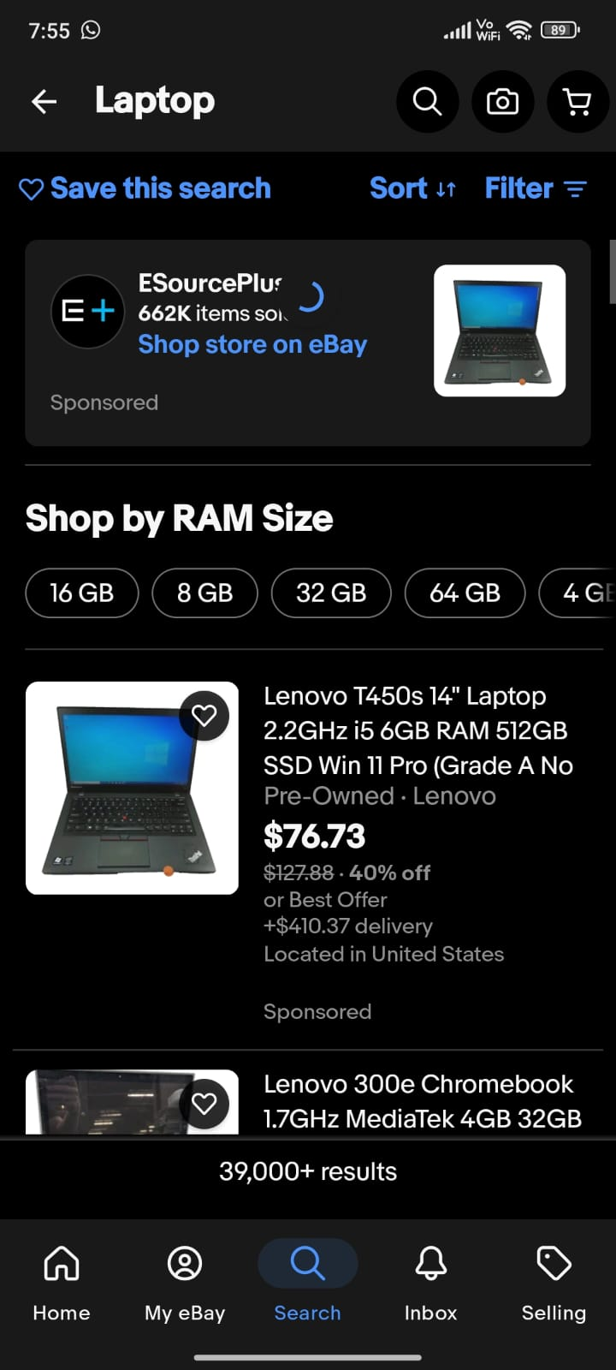

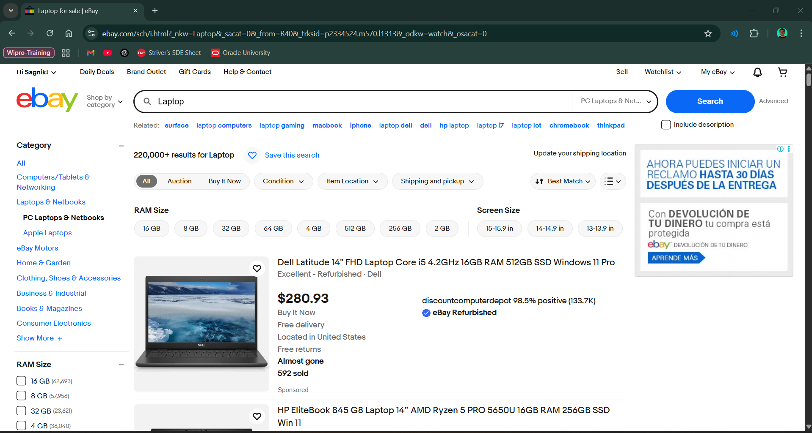

Slide 9
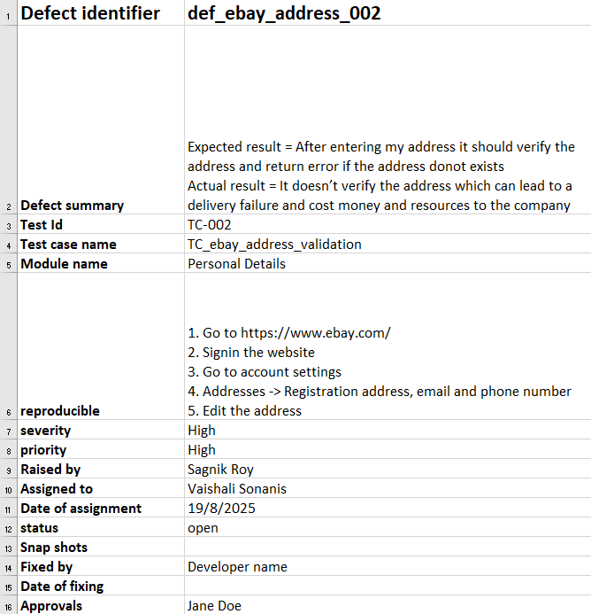

Slide 10
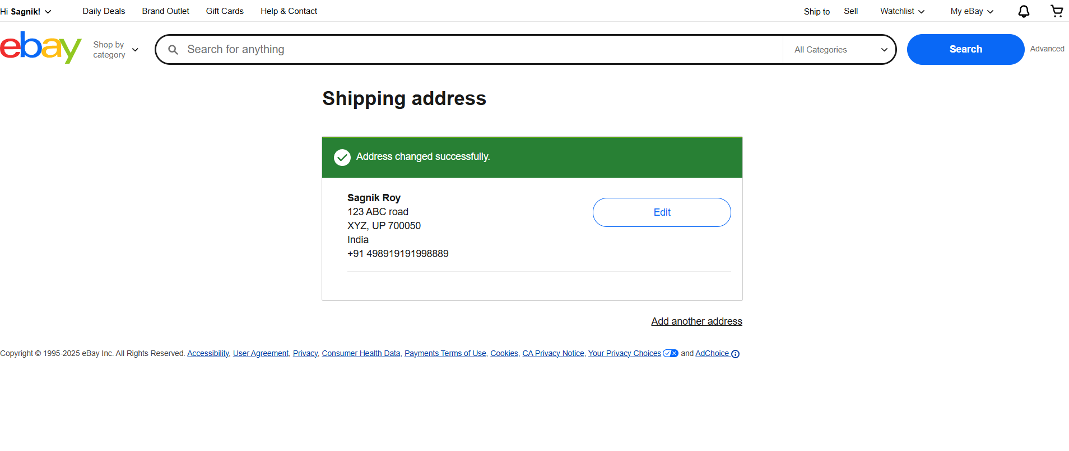

Slide 11
Challenges
While testing big website which contains huge data we faced some challenges about:
E-bay is a globally deployed application, Dynamic website which changes constantly so we need to keep up with it
Due to fluctuations in Network connection some features get slowed or delayed, so we often need to reverify 2-3 times
During high traffic cases like sales and offers the server often gets slowed.

Slide 12
Experience
Testing the eBay website alone gave me real-world experience in handling dynamic content, complex user flows and cross-browser compatibility issues—challenges I wouldn’t face in textbook examples.
The pros? I gained hands-on skills in functional and non-functional testing and improved my ability to write detailed bug reports.

Slide 13
Thank You!!!
Vaishali Mam For Guiding me through out the Project.

